Slide 1
Encoder
Quantized s/g level x_{q}(nT_{s}) is passed through a binary encoder.
It converts i/p s/g to v digits binary word.
This encoder is also known as digitizer.
An encoder performs the conversion of the quantized signal into binary codes. This unit generates a digitally encoded signal which is a sequence of binary pulses that acts as the modulated output.
As it is a binary encoder, this generates a binary coded sequence. That is transmitted through the transmission path.

Slide 2
It is not possible to transmit each bit of binary word separately on transmission line.
So v binary digits are converted to serial bit stream to generate single baseband s/g.
In a parallel to serial converter, usually a shift register does this job.
So the o/p of a PCM generator is thus a single baseband s/g of binary bits.
In PCM generator, sample & hold ckt, quantizer & encoder together form an Analog to Digital Converter (ADC).

Slide 3
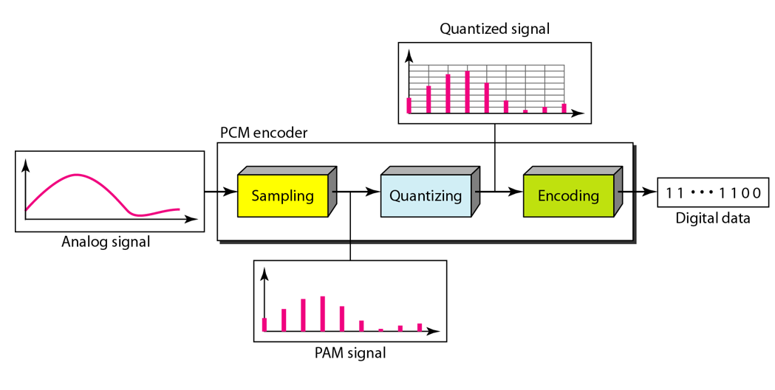
Components of a PCM encoder

Slide 4
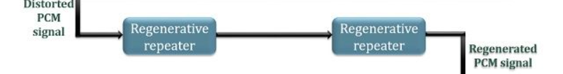
Transmission path in a PCM system
PCM system has a better control over signal distortion introduced during transmission through the channel than other systems. PCM achieves low signal distortion by employing regenerative receivers along the transmission path.
The channel introduces distortion in the signal during transmission. This distortion is eliminated by the regenerator in order to provide a distortionless PCM signal. Thus enhancing the transmission ability of the system.

Slide 5
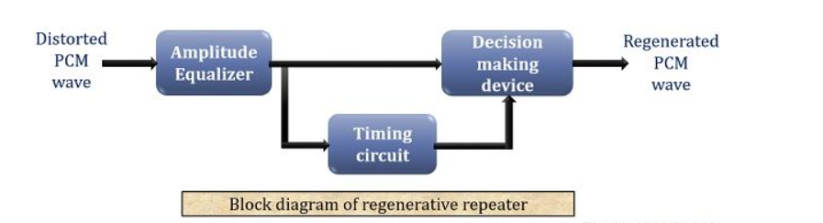
The figure shows the block diagram of a regenerative repeater. It basically performs equalization and timing and then executes decision making.
The PCM signal when provided to the regenerative repeater, the equalizer circuit at the beginning performs the reshaping of the distorted signal. At the same time, the timing circuit generates a pulse train that is a derivative of input PCM pulses.

Slide 6
This pulse train is then utilized by the decision-making device in order to sample the PCM pulses.
This sampling is done at the instant where maximum SNR can be achieved.
A threshold will be set by the decision device. Received pulse will be compared with threshold.
If rxd pulse < threshold pulse----assign 0
If rxd pulse > threshold pulse----assign 1
In this way, the decision-making device generates the distortionless PCM wave.

Slide 7
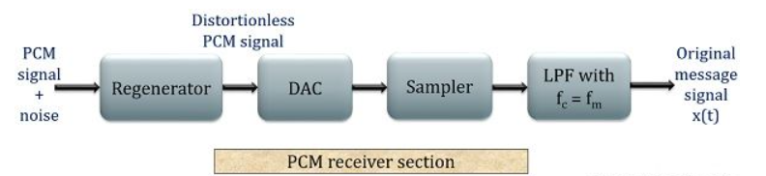
PCM RECEIVER

Slide 8
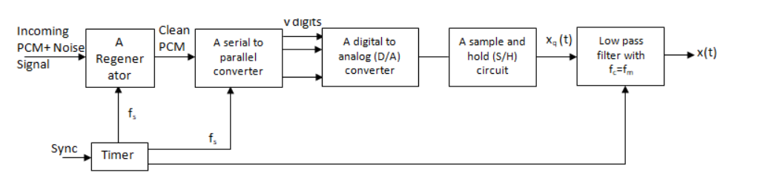
PCM RECEIVER

Slide 9
Regenerator: A regenerative repeater is placed at the receiving end also so as to have an exact PCM transmitted signal. Here, also the regenerator works in a similar manner as that when employed in the transmission path. It eliminates the channel induced noise and reshapes the pulse.
DAC and Sampler (decoder): Digital to analog converter performs the conversion of digital signal again into its analog form by making use of the sampler. As the actual message signal was analog thus at the receiver end there is a necessity to again convert it into its original form.

Slide 10
LPF: The sampler generates analog signal but that is not the original message signal. Thus, the output of the sampler is fed to the LPF having cutoff frequency f_{m}. This is sometimes termed as the reconstruction filter(Interpolation Filter) that produces the original message signal. The process of reconstructing continuous time signal from its samples is called interpolation.
The process done at the transmitter is somewhat reversed at the receiver in order to generate the original analog message signal.

Slide 11
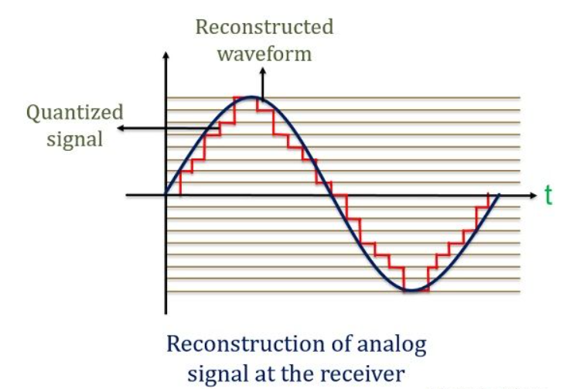
The figure below shows the reconstruction of the actual analog message signal at the receiver.

Slide 12
Transmission bandwidth in PCM
The transmission BW of a PCM system is associated with a number of bits per sample.
If the no. of bits/sample increases, BW also increases.
In order to have a good approximation, a large no. of levels must be used but that will lead to a larger BW requirement.
Let us consider each quantizer level is represented by ‘n’ binary digits. Then the levels represented by n binary digits is given as,

Slide 13
L=2^{n}
L is the digital level of quantizer. Also denoted by ‘q’.
L = q = 2^{n}
Every sample is changed into n bits, thus, a number of bit per sample is ‘n’.
The number of samples per second is f_{s}.
Hence the number of bits per second which is also termed as signaling rate is given as,
r= nf_{s}

Slide 14
As transmission bandwidth is half the signaling rate, hence
Transmission BW in PCM $≥$ half of sampling rate
BW $≥ \frac{1}{2}$ nf_{s} & since f_{s} $≥$ 2f_{m}
BW $≥$nf_{m}

Slide 15
Advantages of PCM
Immune to channel induced noise and distortion.
Repeaters can be employed along the transmitting channel.
Encoders allow secured data transmission.
It ensures uniform transmission quality.
Disadvantages of PCM
Pulse code modulation increases the transmission bandwidth.
A PCM system is somewhat more complex than another system as it includes encoding, decoding & quantizing cktry.

Slide 16
A PCM system transmits data in a coded format, that ensures secured transmission.
But, at the same time needs decoding system at rxr in order to reproduce exact message signal that increases system complexity.

Slide 17
Applications of PCM
With the advent of fibre optic cables, PCM is used in telephony.
In space communication, space craft transmits s/gs to earth. Here txd power is quite small (10 or 15 W) & distances are very large (few million km). However due to the high noise immunity, only PCM s/ms can be used in such applications.

